Slide 1
Benchmarking Circuit Transformation using Noise Injection
Ed Younis
Megan Lilly
Sahar Daraeizadeh

Slide 2
Objective
Evaluating circuit transformers in regard to correctness and robustness to noise
Examples of transformers:
Compilers (mapper, optimizer, …)
Error correction codes

Slide 3
Methodology
Circuit
User input circuits
Random circuits
Circuit benchmarking suite
Transformers
Compilers
Error correction codes
Noise Model
Inject coherent rotations
Comparison
Process fidelity

Slide 4
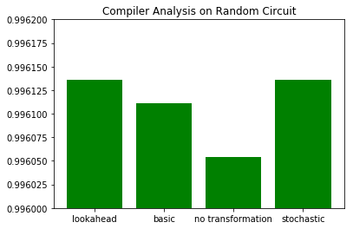
Results

Slide 5
Future Work
Add a transpiler pass to return the final layout of the circuit to the original layout.
Modify the unitary simulator to sample noise models and incorporate Ignis capability.

